Slide 1
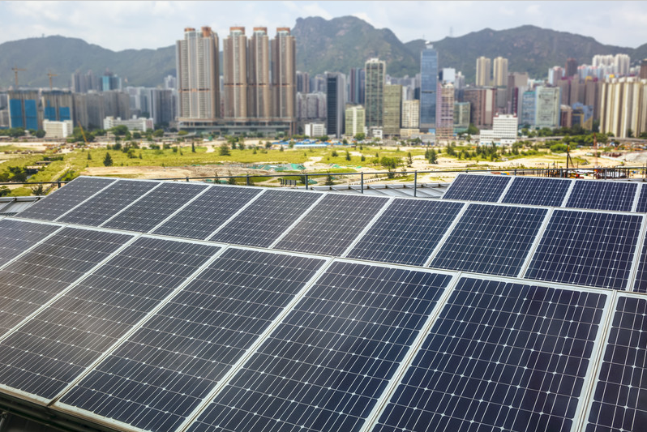
Mass Software Upgrade (MSU)
The Proposal

Slide 2

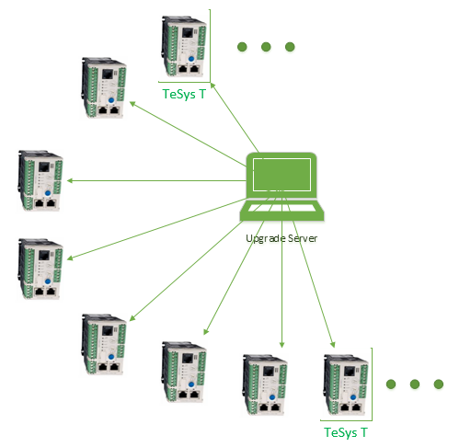
The TeSys-T Case Study
Case 1:
TeSys-T had a firmware issue due to which 7000 devices had to be reprogrammed.
Problem:
Using the conventional methods of Upgrade using FTP, upgrading 7000 devices can take 24 days! Considering 5 minute for 1 device
Case 2:
Gelasolar plant have 2650 device for mass upgrade
Problem:
Using SGBackup tool take 6 Hr for 2650 device and new site have plan to add 10000 + device then upgrade time will increase in scale of increase in no of device
Catch
Maintenance in a typical solar power plant is allowed 8-10 hours (non-operating hours in the day when there is no sunlight). Let alone 24 Hrs, it was beyond unacceptable

Slide 3

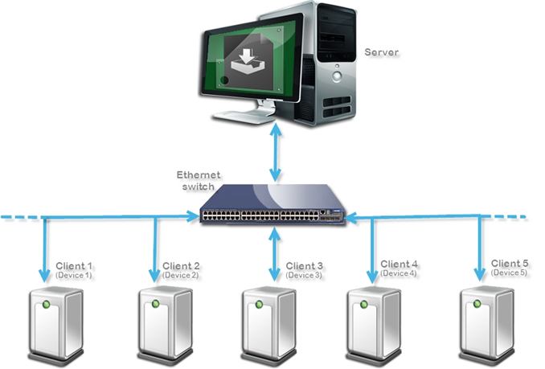
Mass Software Upgrade (MSU) Protocol
The Mass Software Upgrade protocol is implemented on the client devices onto which the upgrade is performed by the MSU Server.
The protocol enables the same mass upgrade at an exponentially small time. For the TeSys T case, MSU can perform the upgrade for 7000 devices in 2.3 hours!
This is achieved by creating 28 batches each of 250 devices, 28 cycles taking 28* 5 minutes = 2.3 hours.

Slide 4

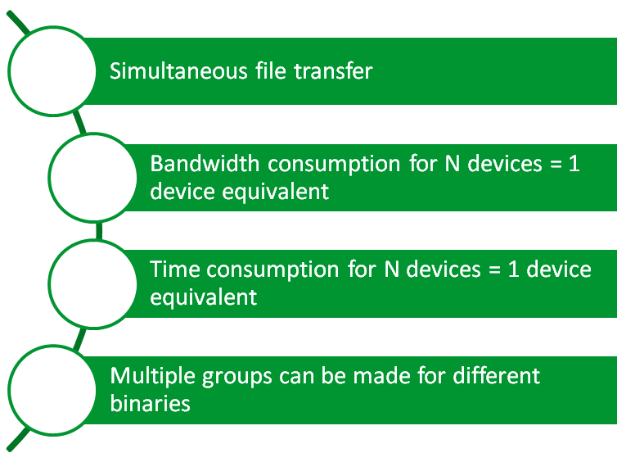
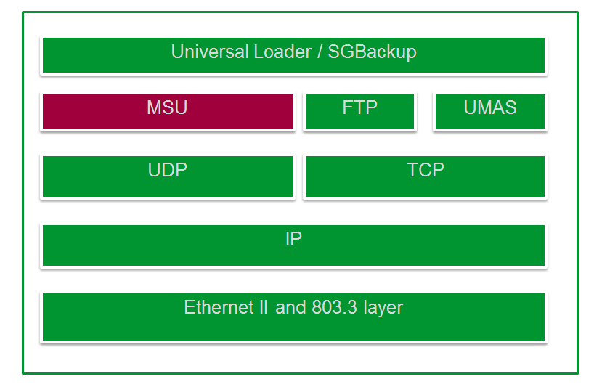
Why MSU?

Slide 5

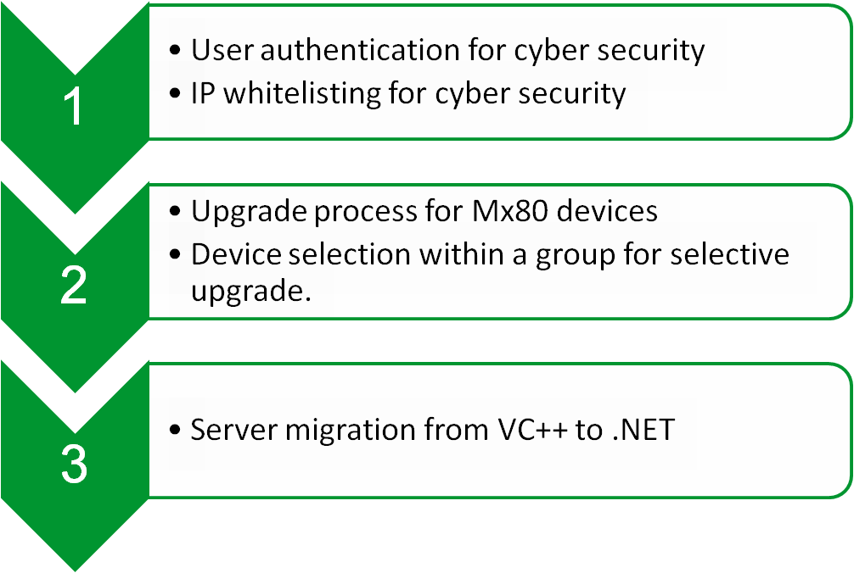
The Road Ahead

